Slide 1
Welcome to CodeSpace
Python with Robots Mission 1

Slide 2


Pre-Mission Warm-Up
In your Mission 1 log, answer the pre-mission warm-up question:
What do you know about computer science or programming?

Slide 3
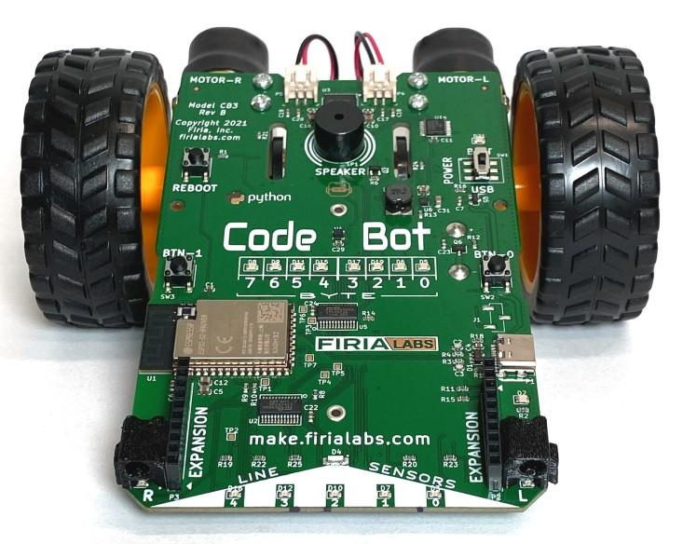
What is CodeSpace?
A powerful online learning and coding environment. With CodeSpace you will:
Learn to code in Python.
Complete missions.
Test your code on a physical device.

Slide 4
What is CodeSpace?
It is a programming development environment that includes a text editor, or a place to type code.
After you type code, or instructions for the computer, CodeSpace changes the code to simple commands a computer can understand.
The commands are sent to the CodeBot, which is a physical device.
Finally, the CodeBot follows the commands.

Slide 5

Objective #1: Mission objectives
Objectives are found on the right side of CodeSpace, in a vertical panel.
Each objective has at least one goal.
Hide the instruction panel by clicking on 1
Unhide the instruction panel by clicking on 1 again.

Slide 6
Objective #1 Activity
DO THIS:
Hide the instruction panel by clicking on 1
Unhide the instruction panel by clicking on 1 again.

Slide 7
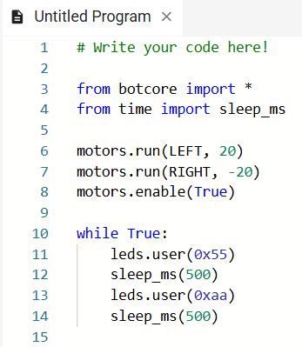
Objective #2: Text editor
The text editor is on the left side of CodeSpace.
It is where code will by typed.

Slide 8
Objective #2 Activity
DO THIS:
Click on a line of code in the text editor and make a change. You can:
Change a number
Add a blank line
Copy and paste a line of code
Change True to False
Make a change to the code.

Slide 9

Objective #3: Toolbox
The toolbox is in the lower right corner of CodeSpace.
Right now the toolbox is empty.

Slide 10

Objective #3 Activity
DO THIS:
Add a “tool” to the toolbox by clicking on
See your word and read the toolbox entry.
Go to your mission log and write something you read in the entry.
Close the toolbox.
Open the toolbox again by clicking the icon.
You will see the “tool” you added!

Slide 11
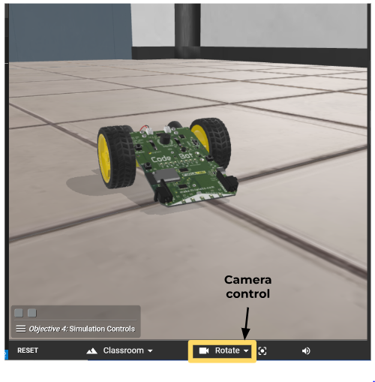
Objective #4: Simulation controls
The camera controls are at the bottom panel of CodeSpace.

Slide 12

Objective #4 Activity
DO THIS:
Close the instruction panel.
Click on the triangle to open the camera controls.
Click on
Close the help panel.
Use your mouse or trackpad to rotate the view. The scene should spin several times to meet the goal.

Slide 13

Your first mission quiz
You have learned a lot about CodeSpace. Now …. time for a quiz!
Answer two quiz questions.
Read the “completed mission” message and click to complete the mission.
CODEX
QUIZ

Slide 14
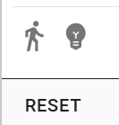
CodeSpace Review
You have learned a lot about CodeSpace. It has a few more parts you should know about.
CodeTrek
When you have code to type, CodeTrek will be your tutor and help you know what and where to type the code.
Hints
Hints are included when additional information is available. You should always read the Hints.

Slide 15

CodeSpace Review
Sandbox
The sandbox lets you try code without any instructions or goals to meet. It is a good place for coding remix projects or your own original programs.
Open Console
The console lets you type a code instruction and see what happens without having to create and run a program. It also keeps track of variables. You will use it for a variety of things.

Slide 16
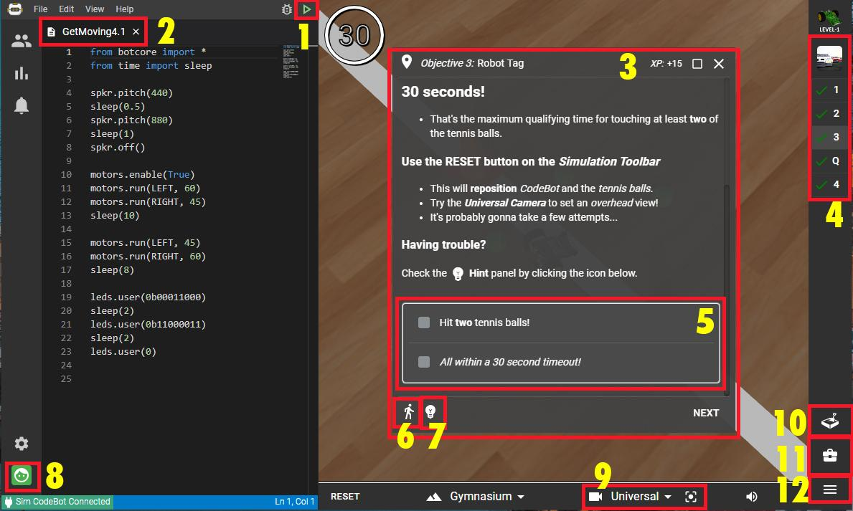
CodeSpace Review
Your turn for a review.
Go to your mission log and label the parts of CodeSpace.

Slide 17
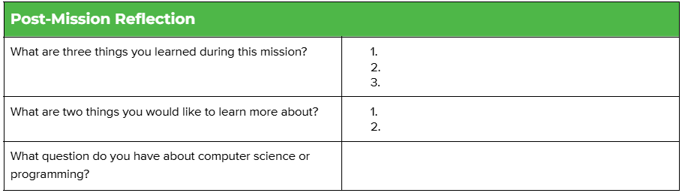
Post-Mission Reflection
Complete your post-mission reflection in the mission log

